Slide 1
Visualization and visual workflows
14 September 2012, 9.30-10.30
Notes:
Introduce concept of visual workflows. Yahoo pipes, PISE, Keppler, Galaxy, Taverna, Genome browsers.

Slide 2
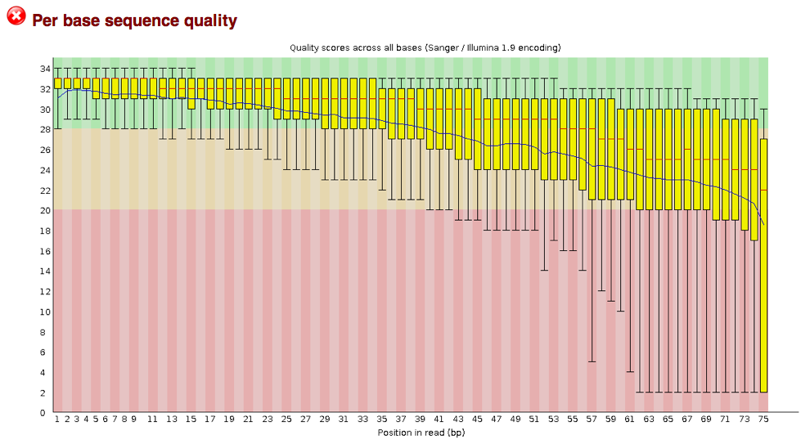
Visualization
Quality control
View alignments, view variation
Browse, annotate full genome
Visualize analysis steps

Slide 3
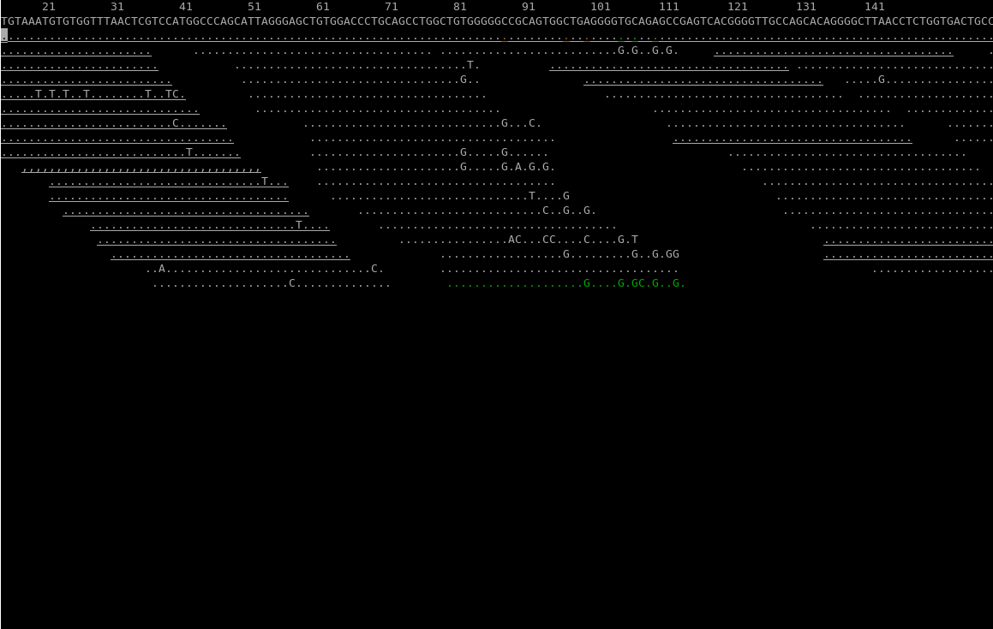
NGS data viewers: tview
See "NGS Viewers Reviewed": http://jermdemo.blogspot.nl/2010/08/ngs-viewers-reviewed.html
http://samtools.sourceforge.net/

Slide 4
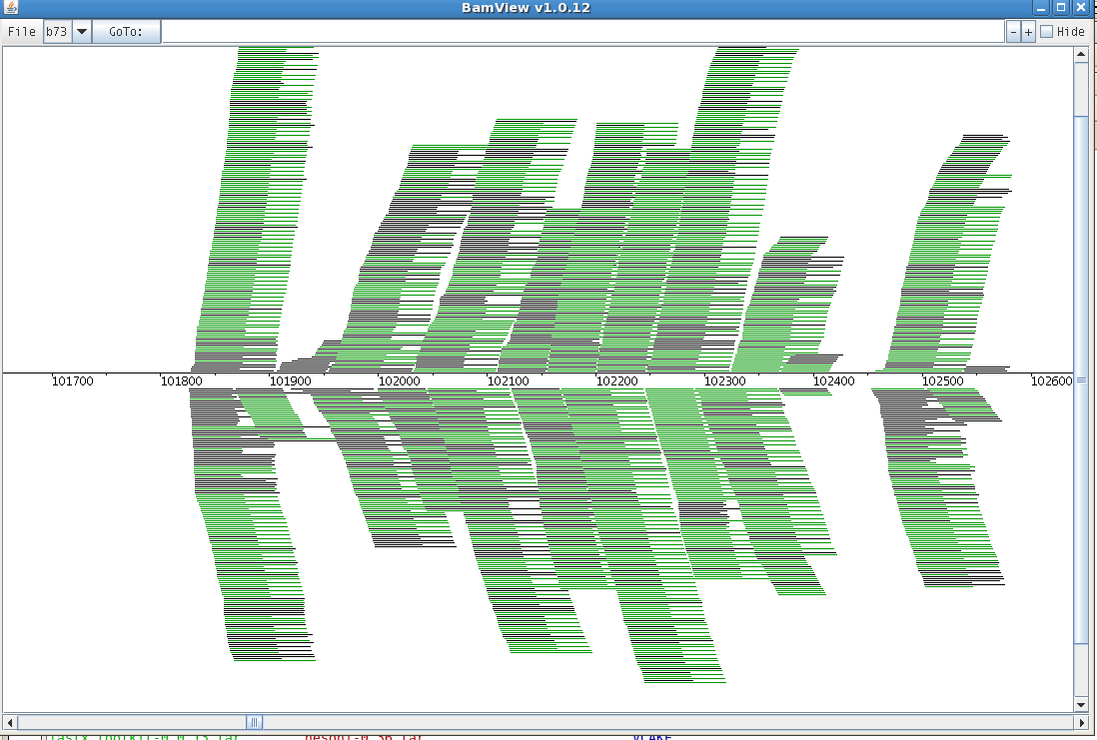
NGS data viewers: BamView
See "NGS Viewers Reviewed": http://jermdemo.blogspot.nl/2010/08/ngs-viewers-reviewed.html
http://bamview.sourceforge.net/

Slide 5
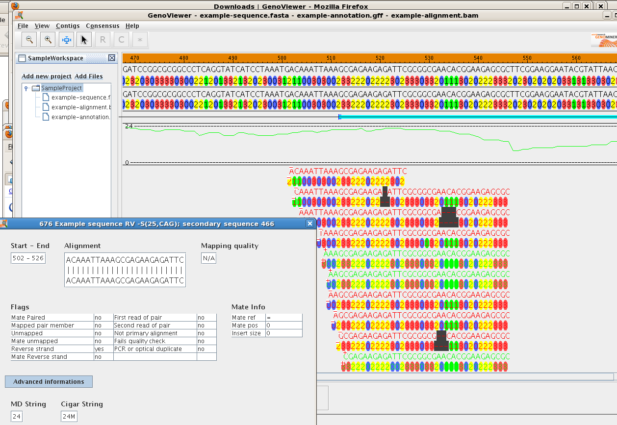
NGS data viewers: GenoViewer
See "NGS Viewers Reviewed": http://jermdemo.blogspot.nl/2010/08/ngs-viewers-reviewed.html
http://www.genoviewer.com/

Slide 6
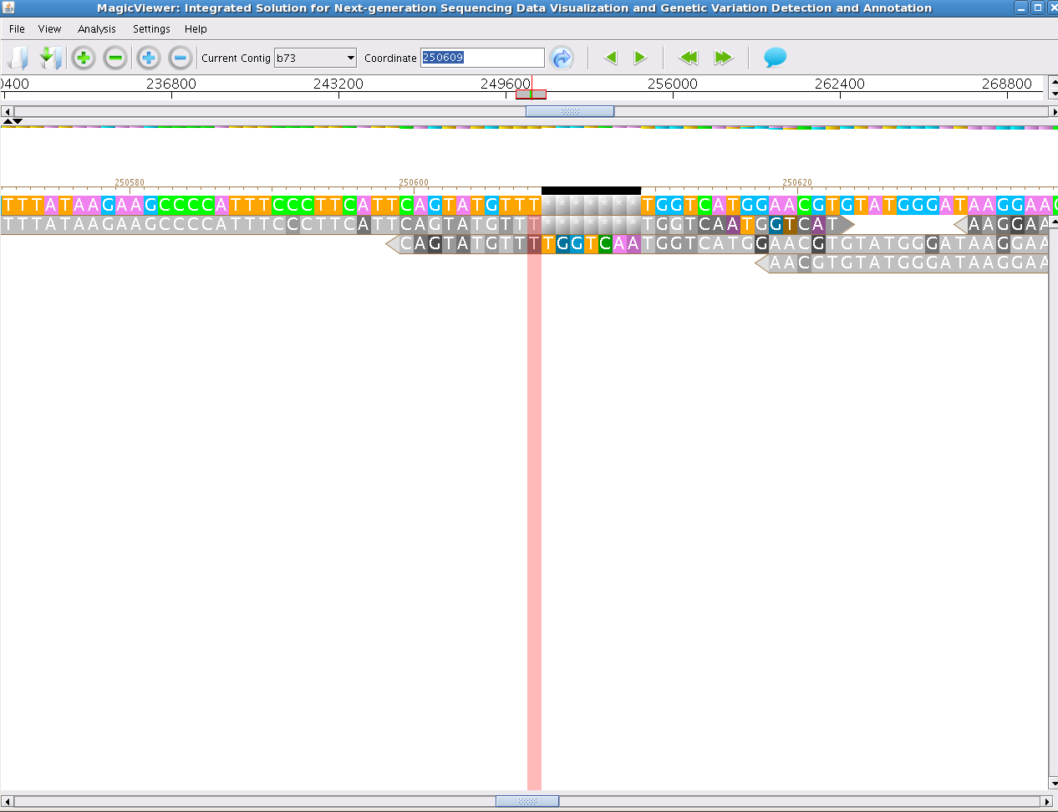
NGS data viewers: MagicViewer
See "NGS Viewers Reviewed": http://jermdemo.blogspot.nl/2010/08/ngs-viewers-reviewed.html
http://bioinformatics.zj.cn/magicviewer/

Slide 7
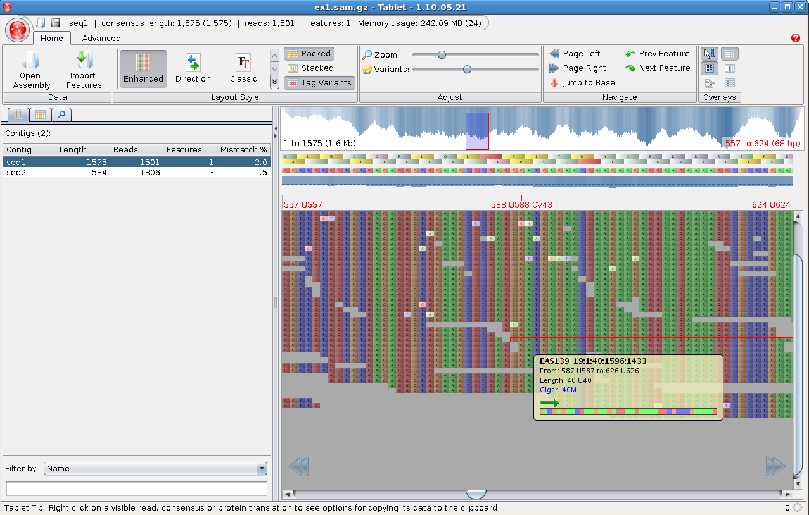
NGS data viewers: Tablet
See "NGS Viewers Reviewed": http://jermdemo.blogspot.nl/2010/08/ngs-viewers-reviewed.html
http://bioinf.scri.ac.uk/tablet/

Slide 8
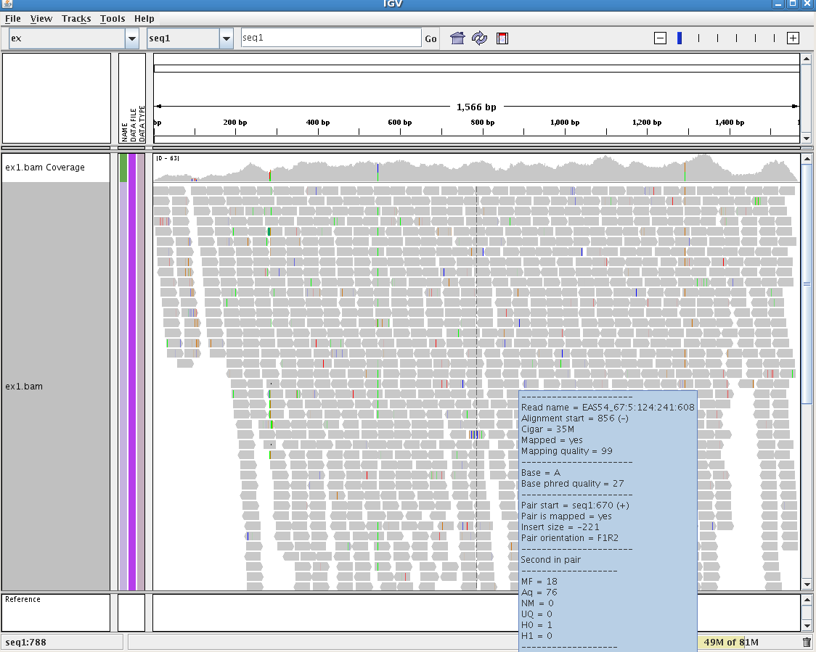
NGS data viewers: IGV
See "NGS Viewers Reviewed": http://jermdemo.blogspot.nl/2010/08/ngs-viewers-reviewed.html
http://www.broadinstitute.org/igv/

Slide 9
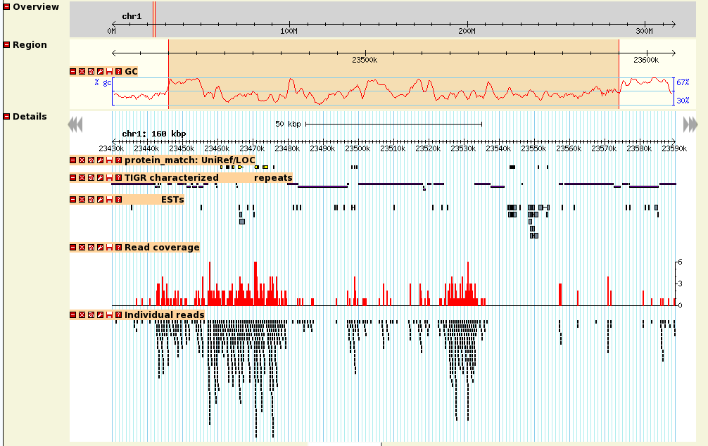
Genome browsers: Gbrowse2
http://gmod.org/wiki/GBrowse

Slide 10
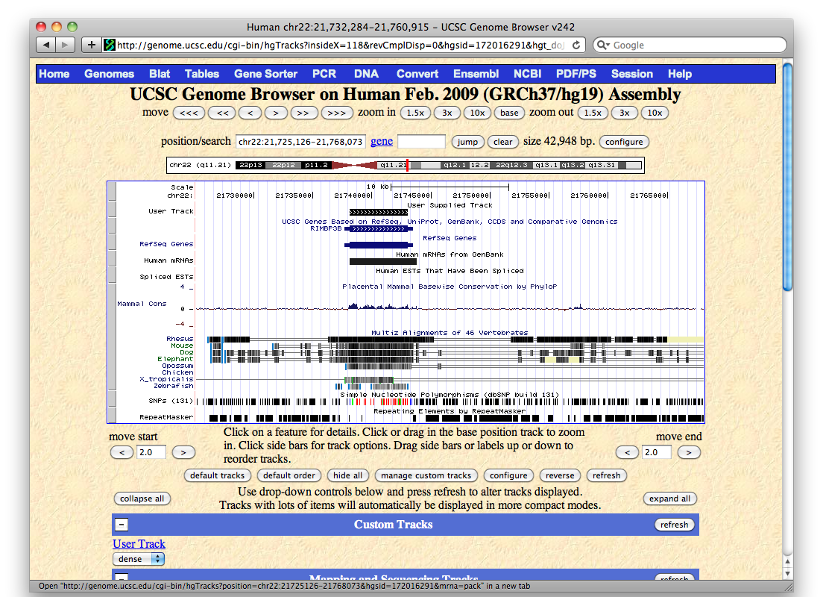
Genome browsers: UCSC
http://genome.ucsc.edu/

Slide 11
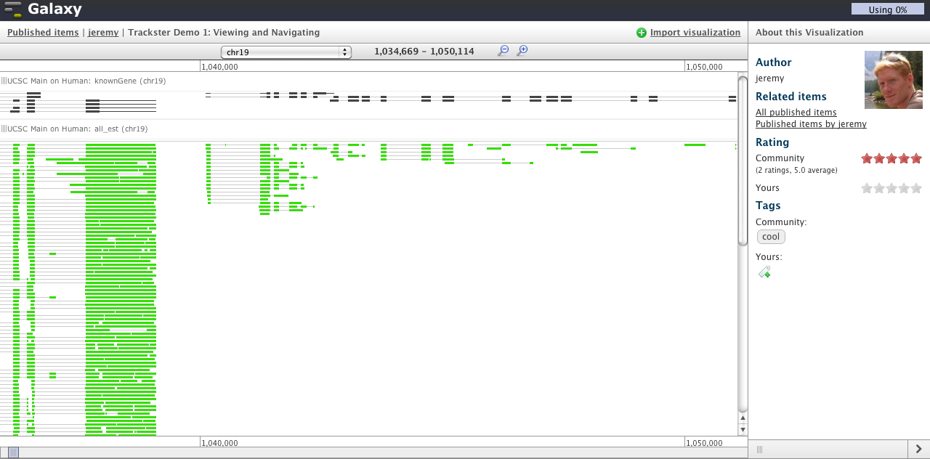
Genome browsers: Galaxy trackster

Slide 12
Visual Workflow Tools
Chain analysis steps together
Manage dependencies
Queue jobs
Share data and workflows

Slide 13
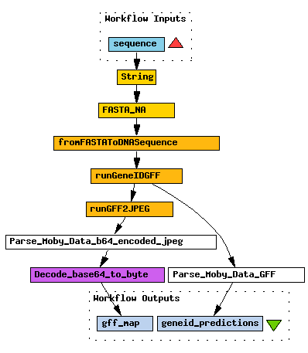
Examples of workflow tools
Taverna | taverna.org.uk
Galaxy | usegalaxy.org
eHive | ensembl.org/info/docs/eHive
Yahoo! Pipes | pipes.yahoo.com
LONI pipeline | pipeline.loni.ucla.edu
GWorkflowDL | gridworkflow.org
BioExtract | bioextract.org
KNIME | knime.org
BioClipse | bioclipse.net

Slide 14
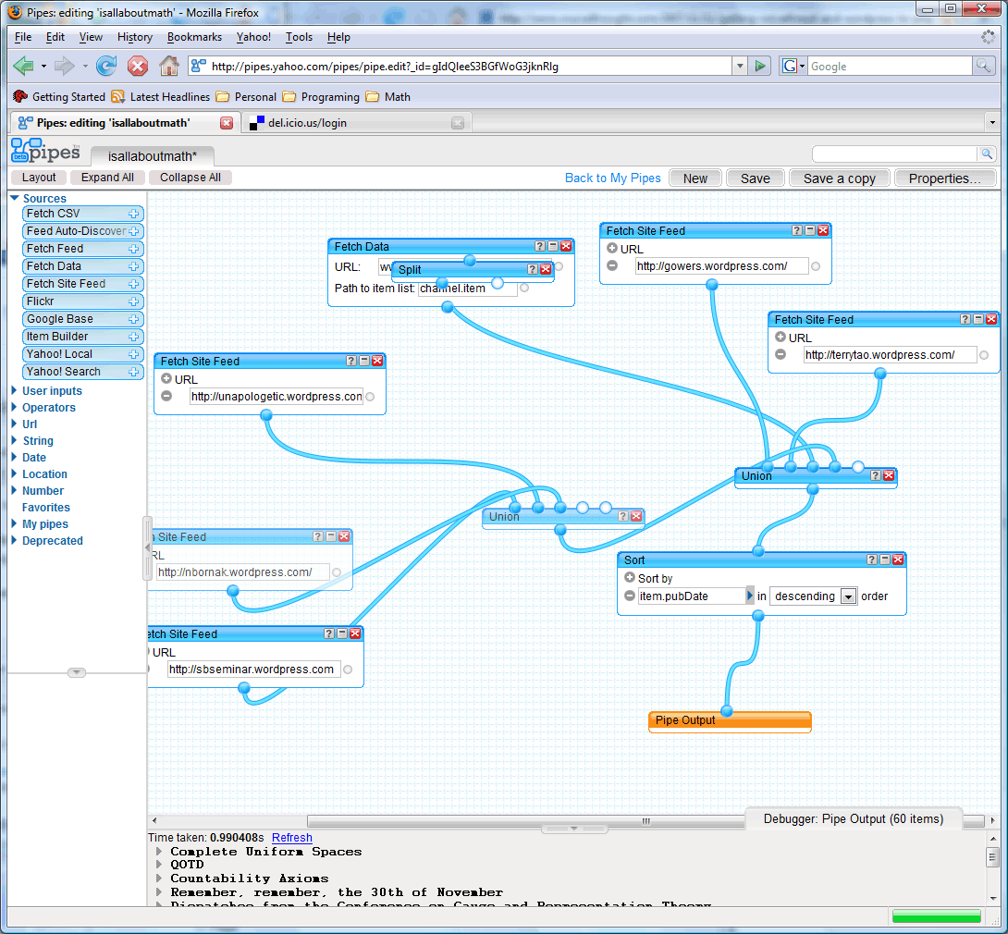
Yahoo! pipes

Slide 15
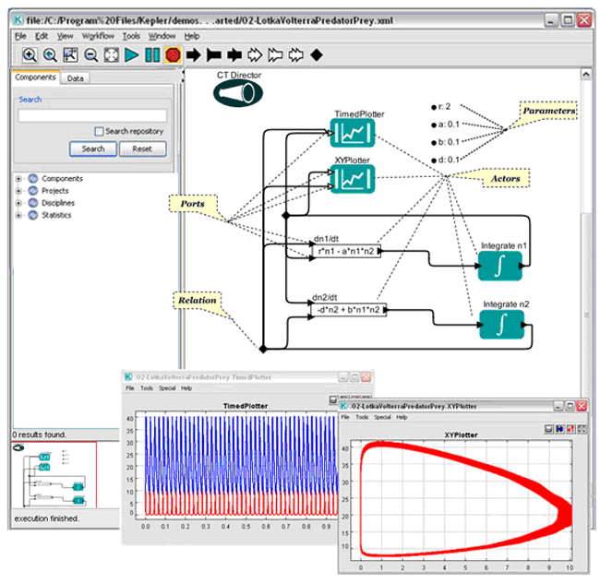
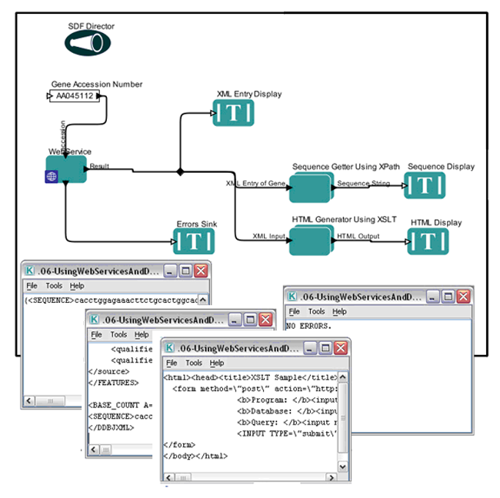
Kepler

Slide 16
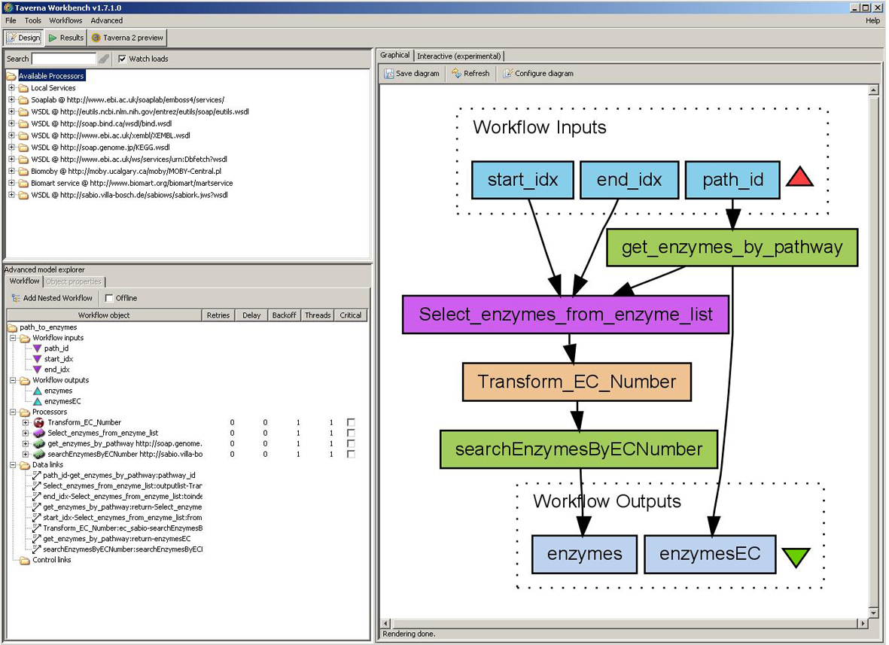
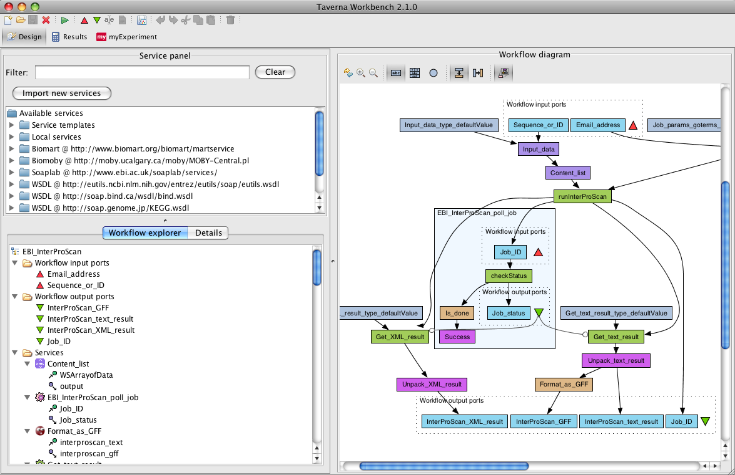
Taverna
Used by BioVeL
Shared on myExperiment
Standalone app based on SOAP web services

Slide 17
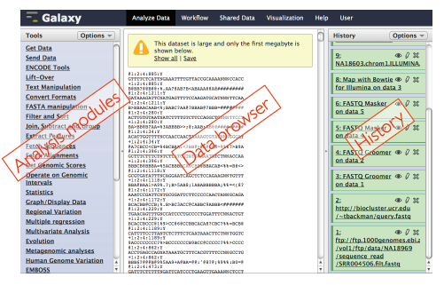
Galaxy

Slide 18
Galaxy tools
Send and Get data – Upload, fetch, send, submit
Data manipulation – Join, sort, filter
Format conversion – FASTA, other format operations
Statistics – Regressions, simulations, model tests
NGS – BAM, FASTQ, SOLiD, 454 file operations
RNA analysis – cufflinks, tophat
Evolution – branch lengths, NJ, HyPhy

Slide 19
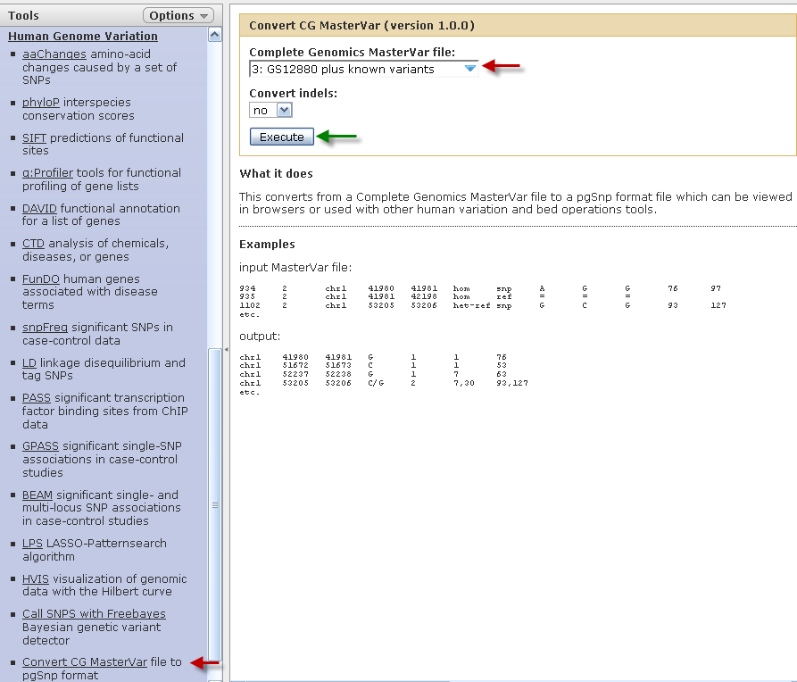
File format conversion
Built-in converters between related file formats are provided
Additional converters can be added

Slide 20
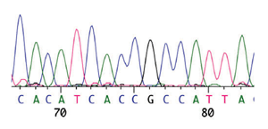
Galaxy sequence formats
FASTA – def line, sequence
FASTQ – FASTA + quality - SOLEXA:
ABI/SCF – binary sequence trace (see below)
SFF (454) – binary flowgram format

Slide 21
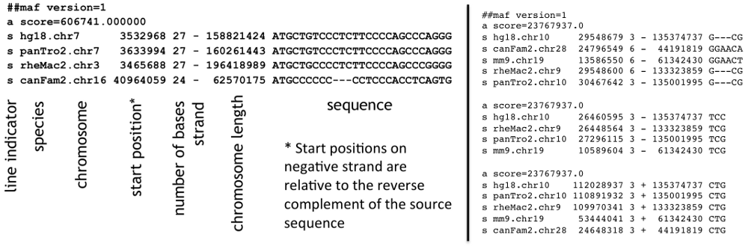
Galaxy alignment formats
MAF – multiple alignment format (see below)
(S|B)AM – text or binary format for reads and ref
AXT – pairwise alignment, from LAV
LAV – BLASTZ output, pairwise alignment

Slide 22
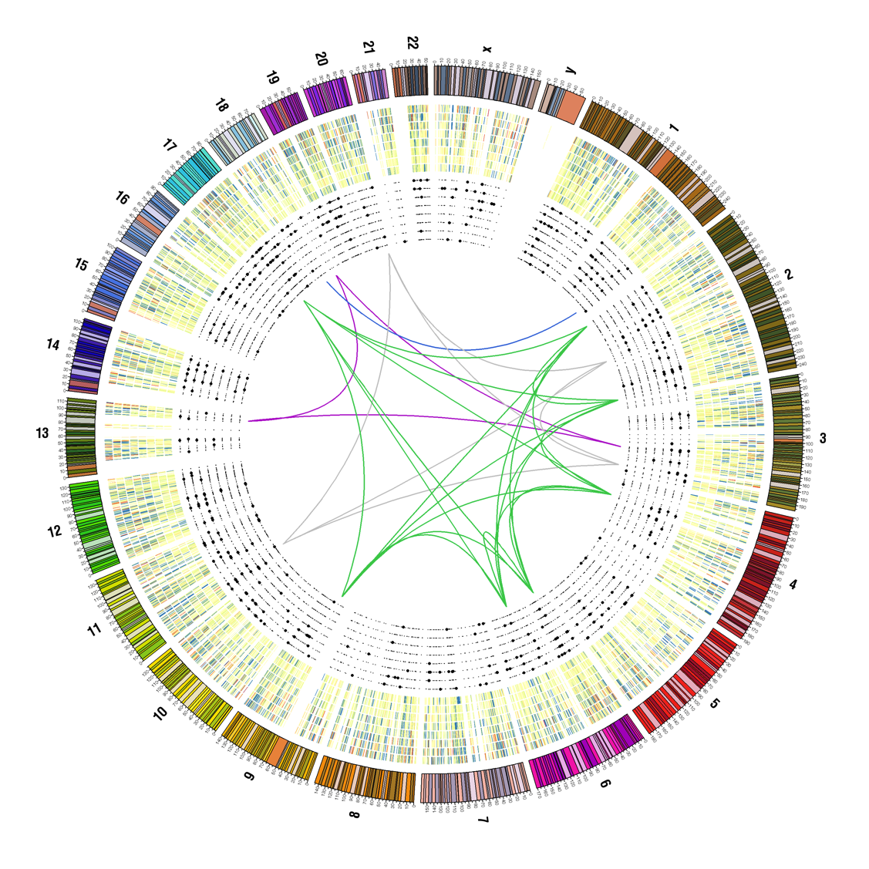
Galaxy interval/feature formats
BED
chrom, start, end, …
INTERVAL
BED with headers
GFF (GFF3)
like BED and interval, but 1-based inclusive
WIG(GLE)
dense, continuous-valued tracks

Slide 23
Other data formats
In addition to interval/feature tabular data as listed previously, other files with similar properties can be processed by some tools:
*.txt tab-separated values (e.g. tabular FASTA)
HTML (for additional prose)
LPED/PBED (to describe SNPs, really two files, one for coordinates, other for alleles)

Slide 24
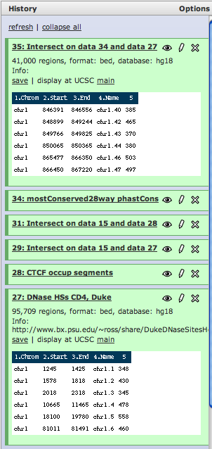
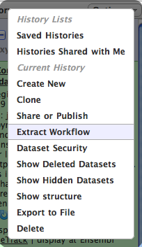
Provenance, histories
Where do the data come from?
How were they altered?
Galaxy tracks the history of data.
Histories can be converted to workflows

Slide 25
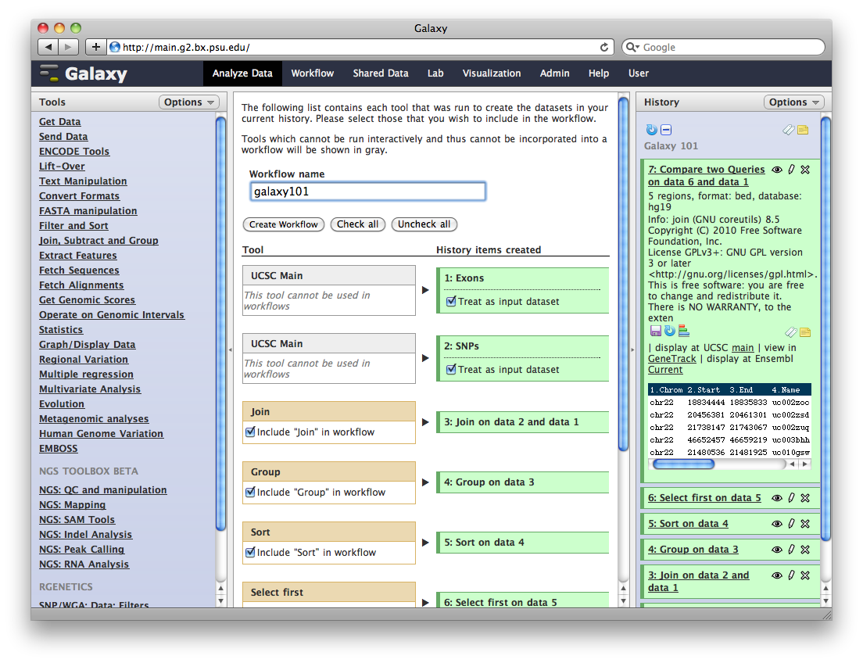
Creating a workflow

Slide 26
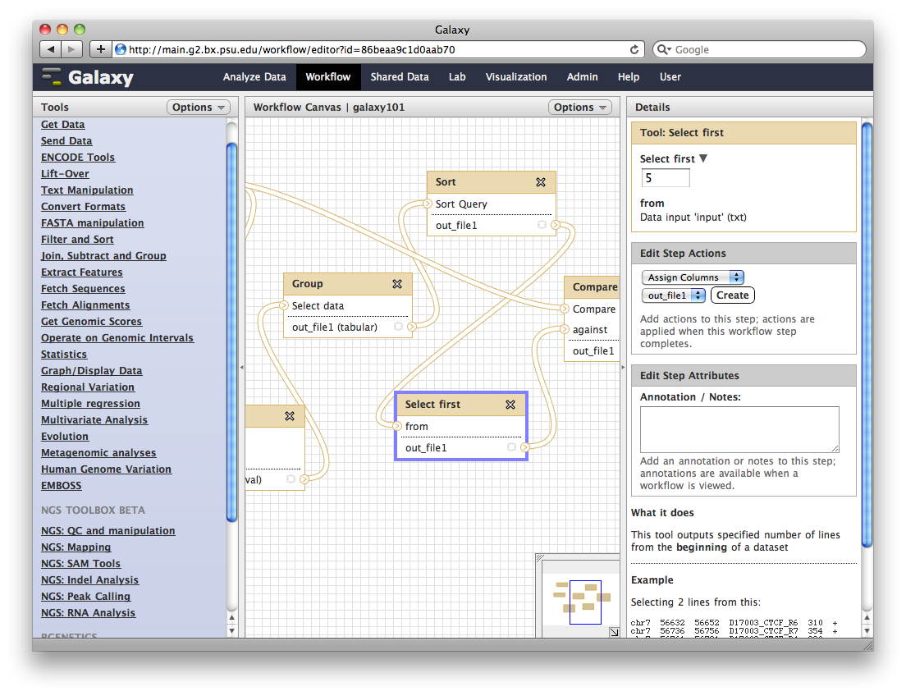
Workflow editor

Slide 27
Exercise: galaxy
Download data from Galaxy's published data site. Go to Shared Data-> Data Library ->Sample NGS Datasets-> Import human illumina dataset to your current history.
Convert Fastq file to sanger sequences Select NGS: QC and manipulation and Fastq groomer
FASTQ summary statistics To understand the quality properties of the reads, one can run the FASTQ Summary Statistics tool from NGS: QC and manipulation.
Quality boxplots A graphical representation of these data facilitates its quality assessment. The plot can be readily produced with the tool Graph/Display Data -> Boxplot.
Trim low quality tail off reads and mapping with Bowtie Go to NGS: Mapping and choose Bowtie. Once Bowtie's interface is displayed in the center, select hg19 from Select a reference genome, then select Full parameter list, and set 10 for Trim n bases from low-quality (right) end of each read before alignment (-3) to trim off the low quality tails from the reads.
Convert SAM to BAM. For the import into IGV one needs to convert the SAM format into its binary BAM representation by using the NGS SAM Tool -> SAM to BAM.
Adapted from http://manuals.bioinformatics.ucr.edu/home/gui-ngs-analysis
Notes:
Make an account

